Slide 1
Rajshahi University of Engineering & Technology
CSE 3200 Software Development Project II
Submitted by:
1803172 Shanjid Hasan Nishat
shanjidhasan202@gmail.com
Submitted to:
Tasmia Jannat Lecturer
Rajshahi University of Engineering & Technology.

Slide 2





Distracted Driver Detection

Slide 3
Presentation Outline
Introduction
Objectives
Features & Functions
Language & Tools
Justification of using those tools
Future Work

Slide 4
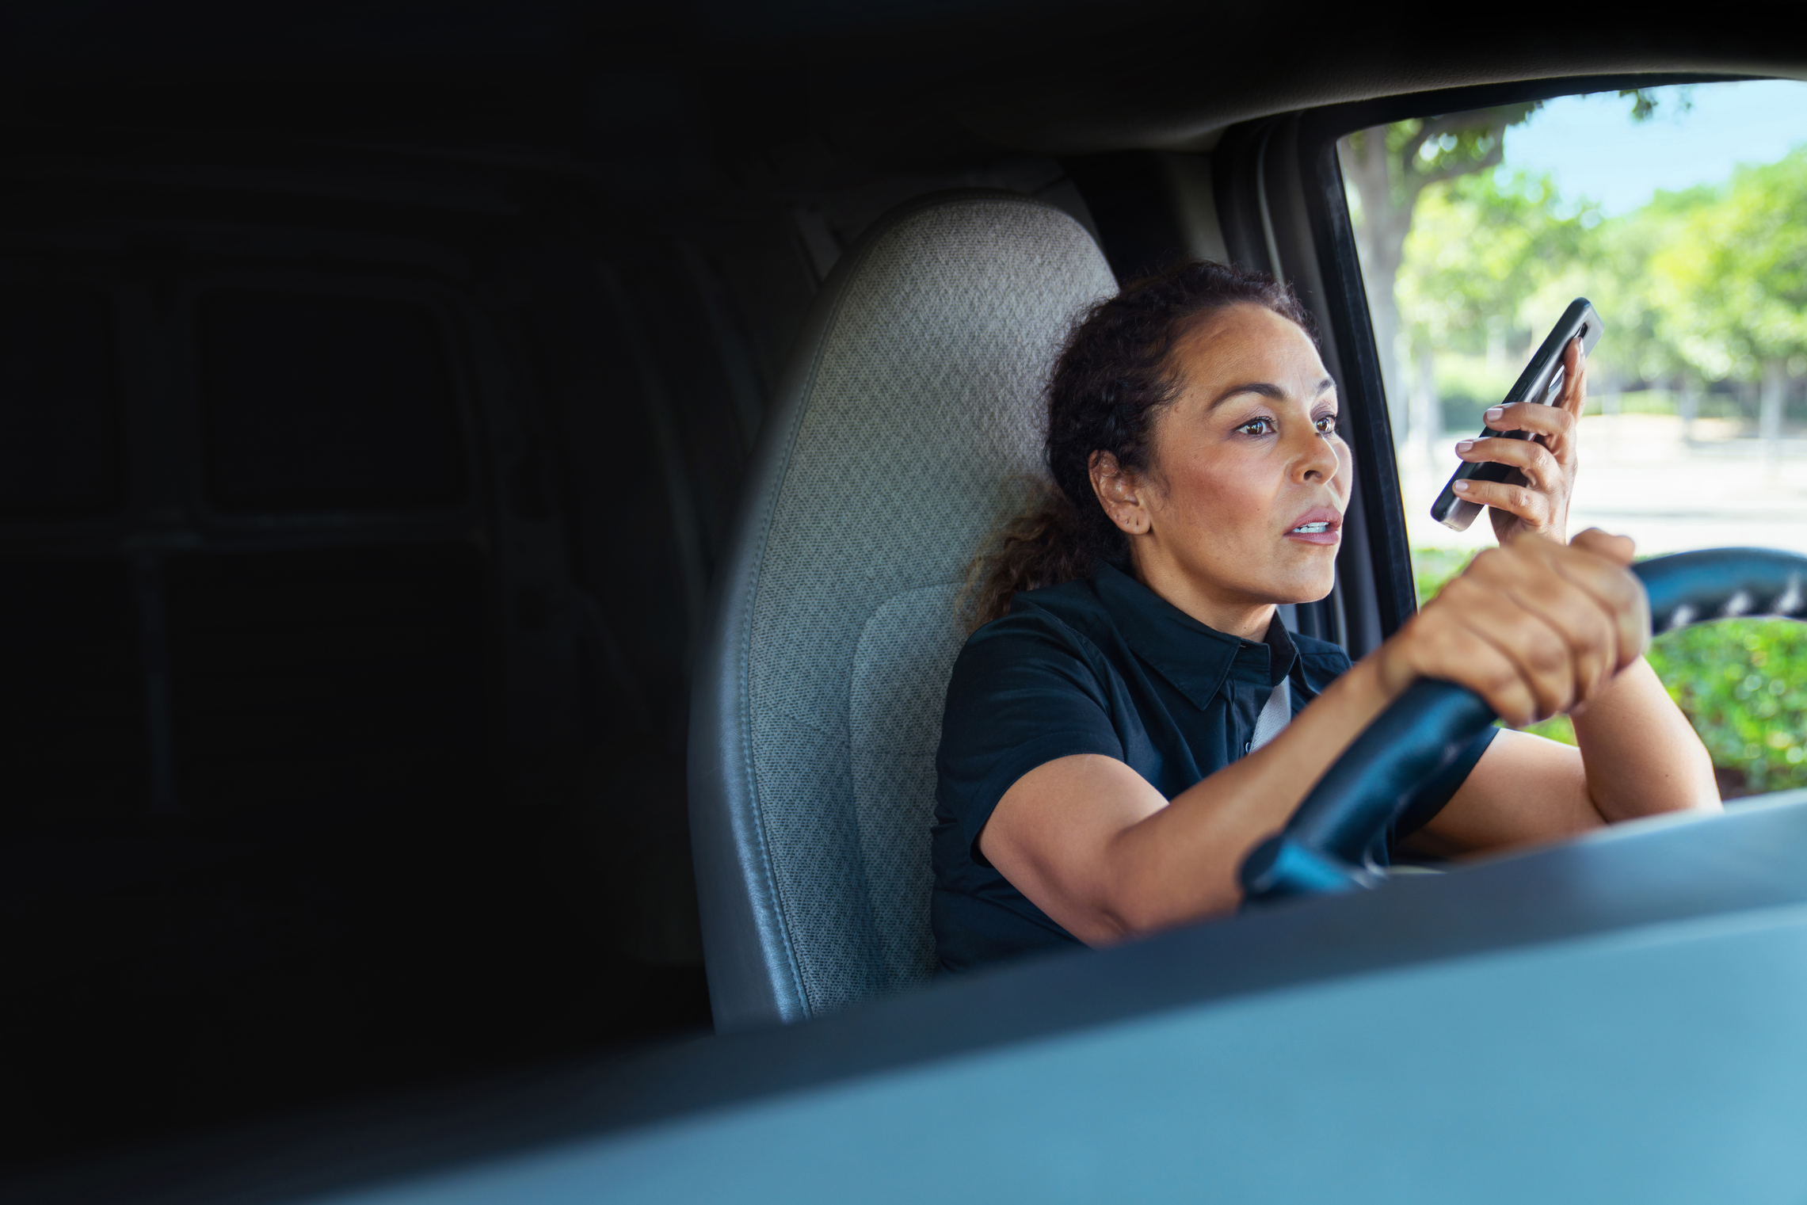
Introduction
Driver distraction constitutes an important factor in the increased risk of road accidents in Bangladesh. These distraction sources can be internal or external. In this project, we will detect drivers distracted by internal sources while driving using dash-cam footage.

Slide 5
Objectives
to detect distracted drivers.
to prevent accidents caused by driver distraction.
to increase drivers' concentration on driving.

Slide 6
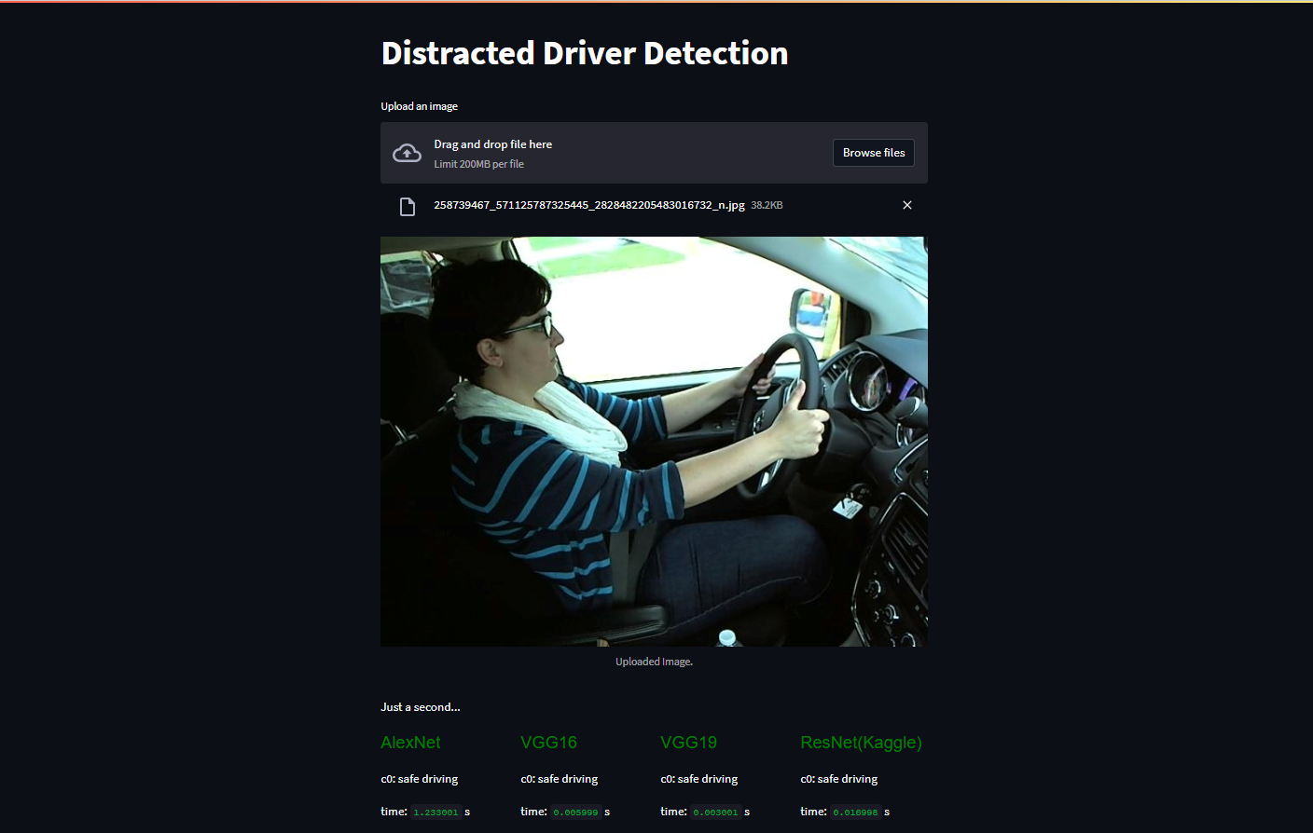
Features & Functions
4 Convolutional Neural Network has been used and compared to classify the image of drivers while driving to detect the distracted drivers

Slide 7
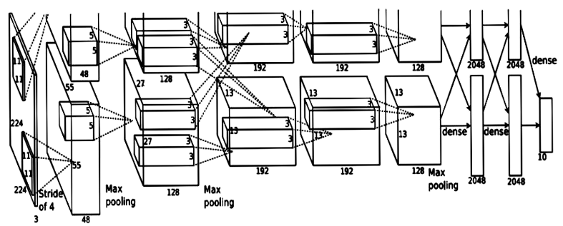
1.
AlexNet

Slide 8
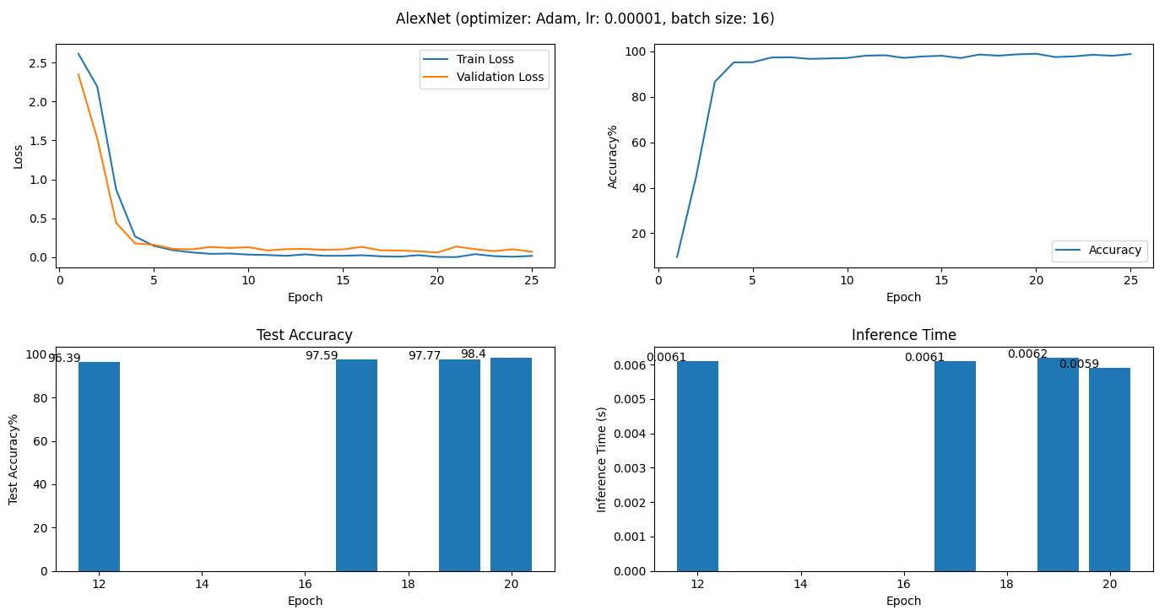
Performance of AlexNet

Slide 9

2.
VGG19

Slide 10
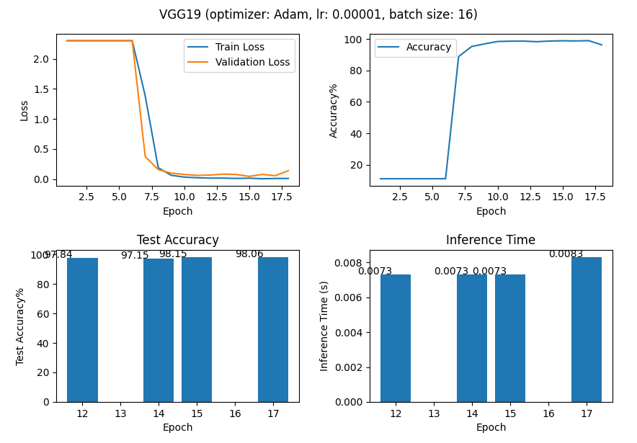
Performance of VGG19

Slide 11

3.
VGG16

Slide 12
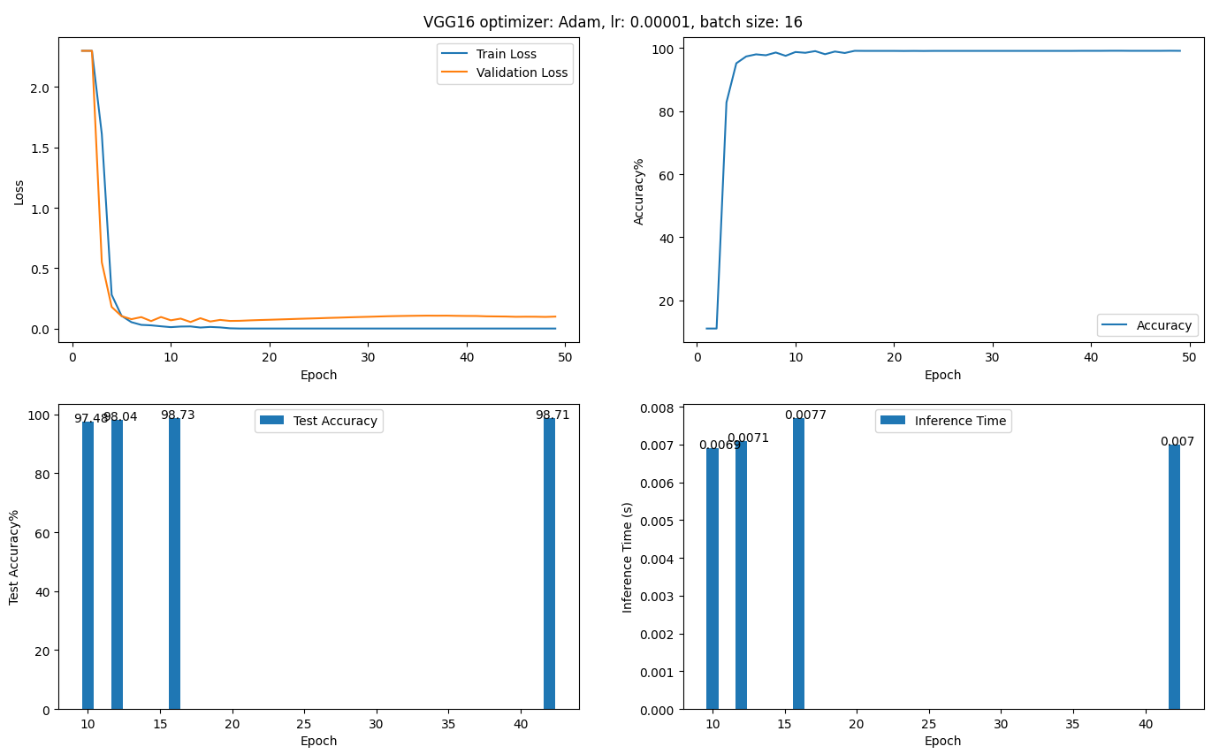
Performance of VGG16

Slide 13
AlexNet vs VGG19 vs VGG16
98.40%
98.71%
98.06%
Test Accuracy
0.0083s
Average
Interface time
0.0070s
0.0059s
AlexNet
VGG19
VGG16

Slide 14
Language & Tools
State Farm Distracted Driver Detection Dataset by Kaggle
A dataset of 2D dashboard camera images of drivers
Python
A popular programming language for machine learning.
CNN
Convolutional neural network (CNN), a type of artificial neural network.
Pytorch
Open source machine learning (ML) framework based on the Python programming language and the Torch library.
Streamlit
Open source framework to create web apps for machine learning.

Slide 15
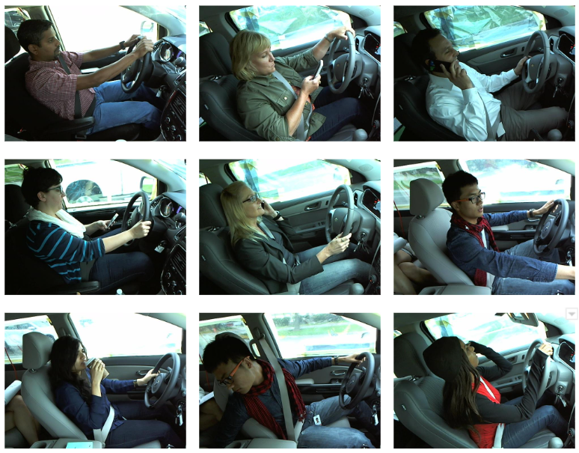
State Farm Distracted Driver Detection Dataset by Kaggle
Classes of the dataset
c0: safe driving
c1: texting – right
c2: talking on the phone - right
c3: texting – left
c4: talking on the phone - left
c5: operating the radio
c6: drinking
c7: reaching behind
c8: hair and makeup
c9: talking to passenger

Slide 16
Python
Python is the mostly used programming language for Computer Vision and Machine Learning experiments because of its open source and easy-to-use wide range of libraries.
CNN
CNN architectures have a great advantage for image recognition and processing, due to its ability to recognize patterns in images.
Pytorch
It provides tensor library fundamentally utilized for Deep Learning applications utilizing GPUs and CPUs

Slide 17
Streamlit
It provides a very easy to use framework to build web application to implement deep learning models is a very short time.

Slide 18









Future Work
Reduce model size
Implement these models in IoT devices to test them with real world environment

Slide 19
References
AlexNet - ImageNet Classification with Deep Convolutional Neural Networks (link)
VGG - Very Deep Convolutional Networks for Large-Scale Image Recognition (link)

Slide 20
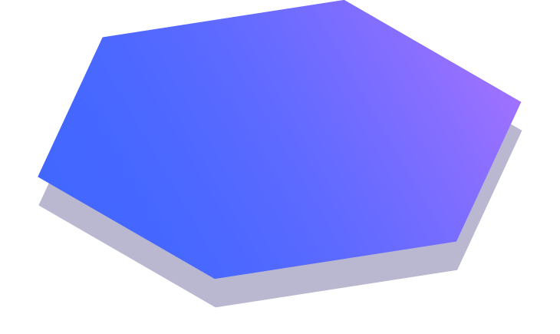
Thanks!
Any questions?

